Slide 1
CLAIMS MANAGEMENT
POD : 1
Hritick Roy
Hrithik Raj Prasad
Mannan Kathuria
Kanika Sharma
Kaimadam Antony Shejin

Slide 2
INTRODUCTION
A leading HealthCare Management Organization wants to strengthen its Middleware by exposing the core logic related to Claims Management as Microservices.
Every hospitals has their own policies, that offers specified benefits which people can claim based on their eligibility.
In this project, we have only focused on few of those hospitals where the eligible users can check the validity of their claims.

Slide 3
SCOPE
The core modules of the Project are :
Claims Module - Claims Module is a Middleware Microservice that performs the following operations:
Get Claim Status
Validate Eligibility of Claim and Action Settlement
Policy Module - Policy Module is a Middleware Microservice that performs the following operations:
Get Chain of Permissible Providers (Hospitals)
Get Benefits permissible under a policy
Get Acceptable Claim Amount per benefit, per policy

Slide 4
SCOPE
The core modules of the Project are :
Member Module - Member Module is a Middleware Microservice that performs the following operations:
View Bills
Submit Claim
View Claim Status
Member Portal - A Web Portal that allows a member to Login and allows to do following operations:
Login
View Bill Status
Verify Claim Status
Submit a Claim

Slide 5
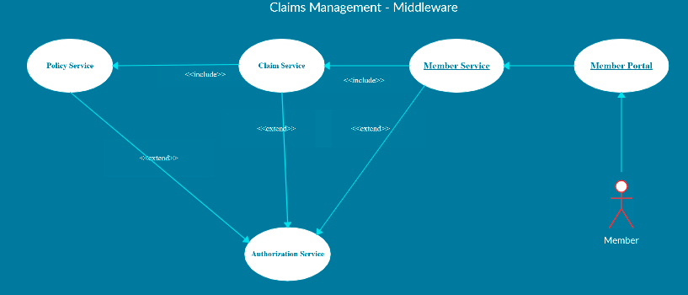
USE-CASE DIAGRAM

Slide 6
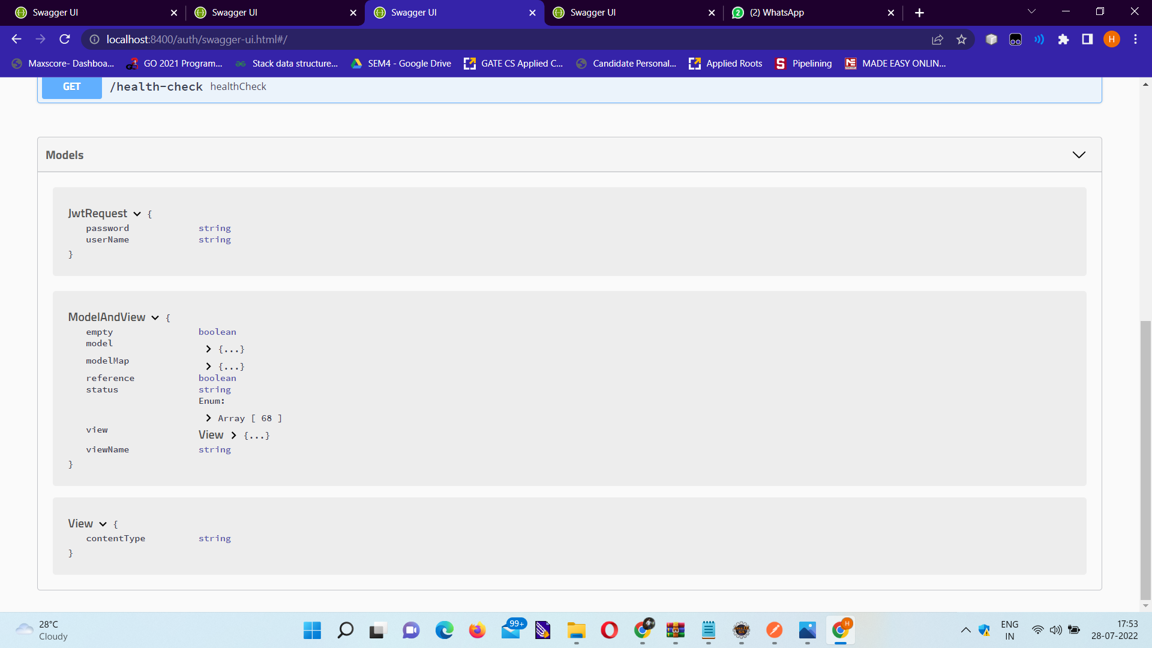
Authorization Microservice Model Classes

Slide 7
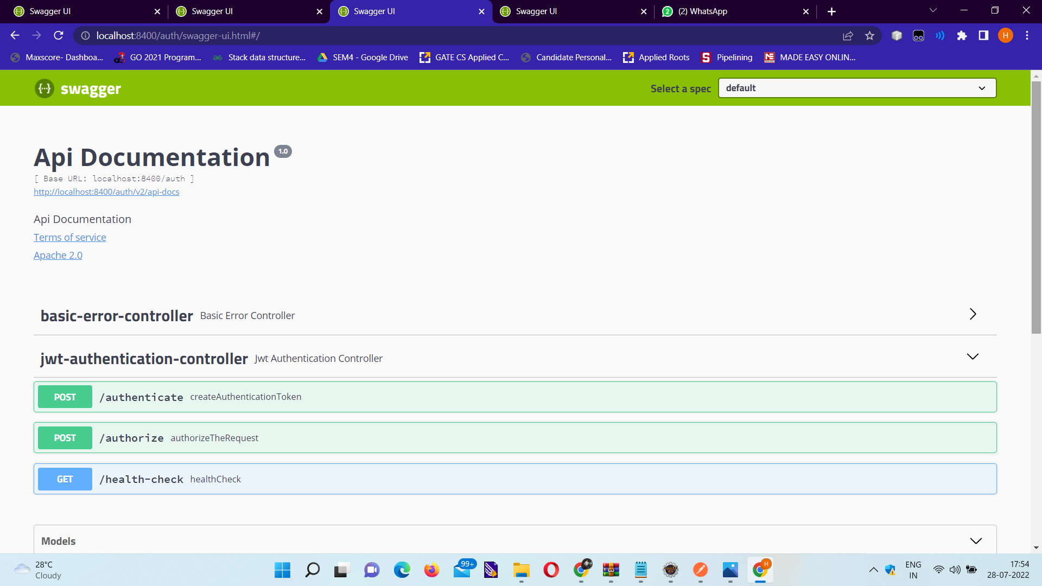
Authorization Microservice EndPoints

Slide 8
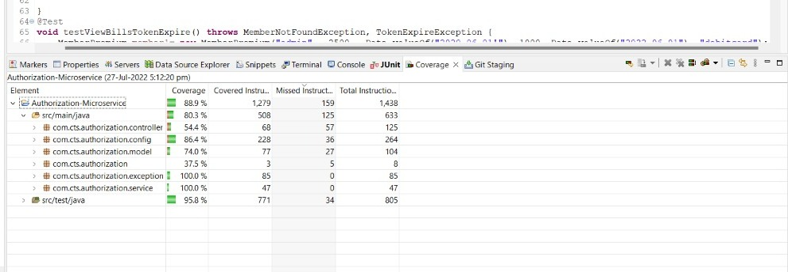
Authorization Microservice Code Coverage

Slide 9
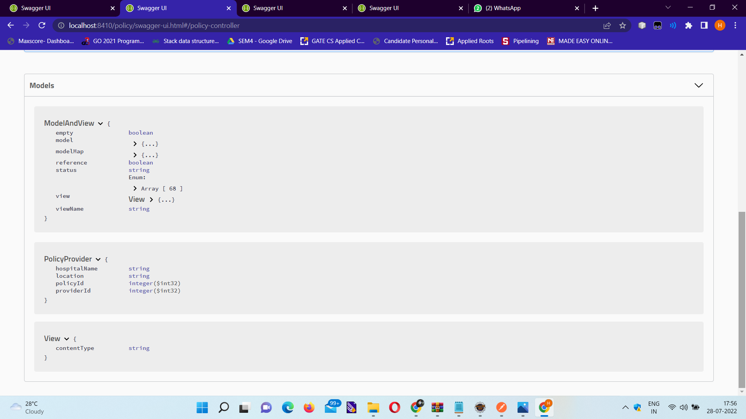
Policy Microservice Model Classes

Slide 10
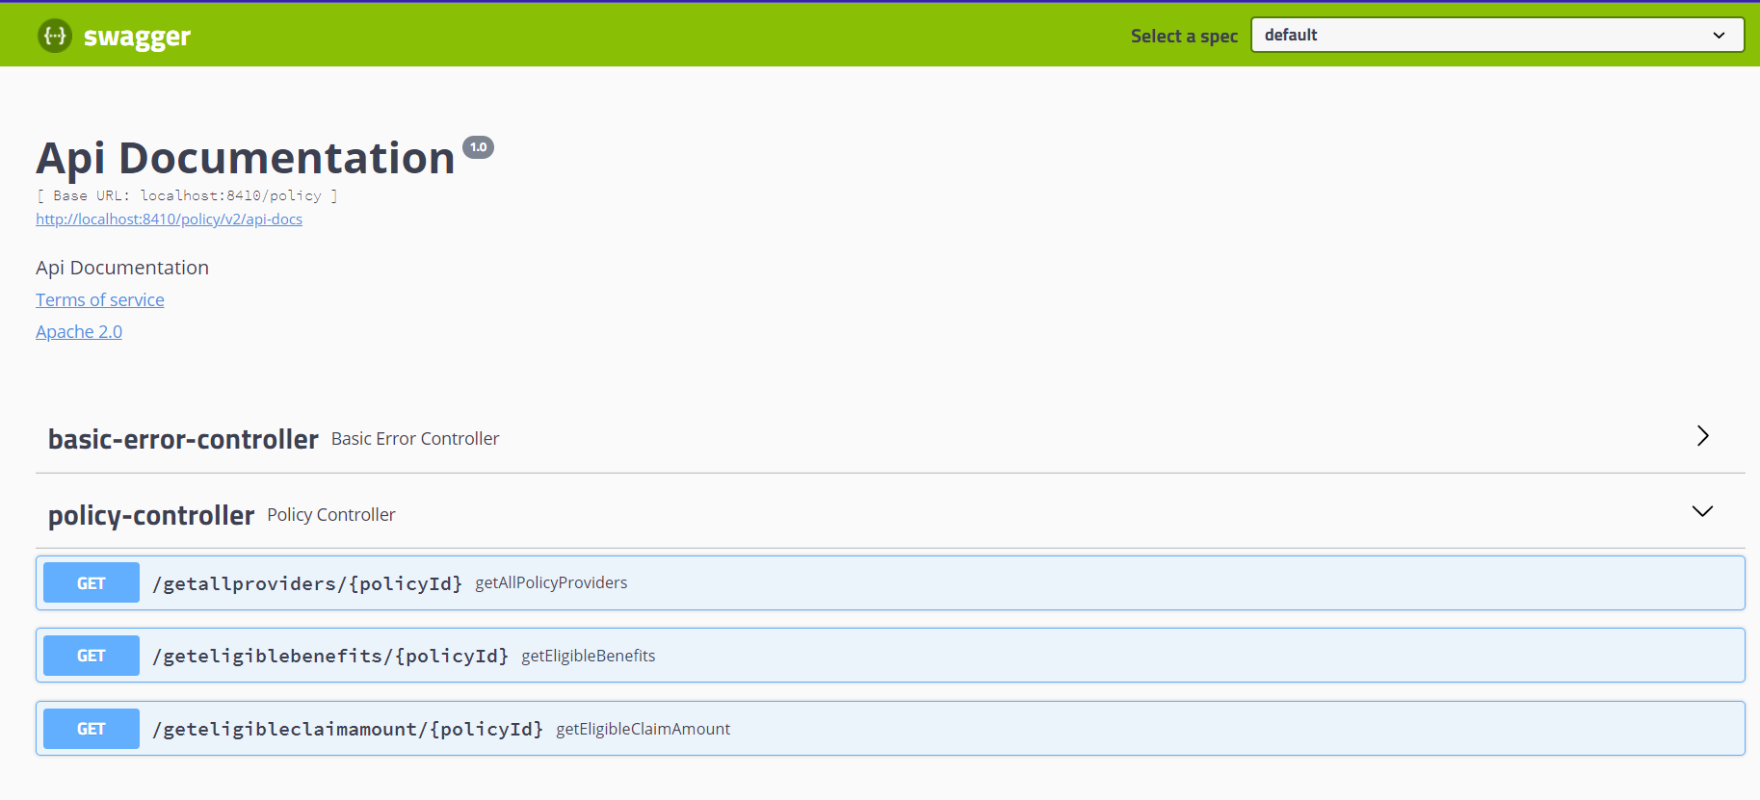
Policy Microservice EndPoints

Slide 11
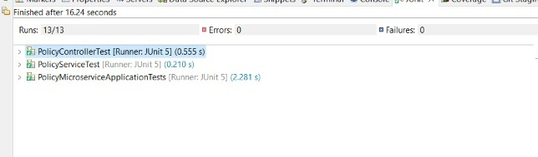
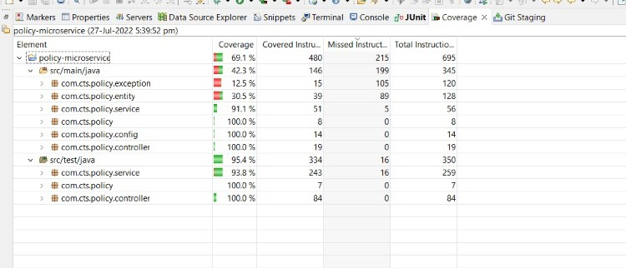
Policy Microservice Code Coverage

Slide 12
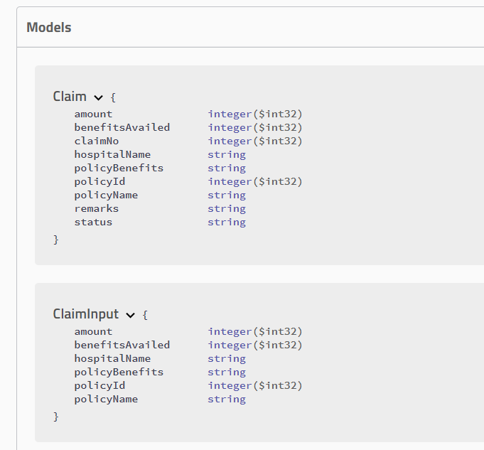
Claim Microservice Model Classes

Slide 13
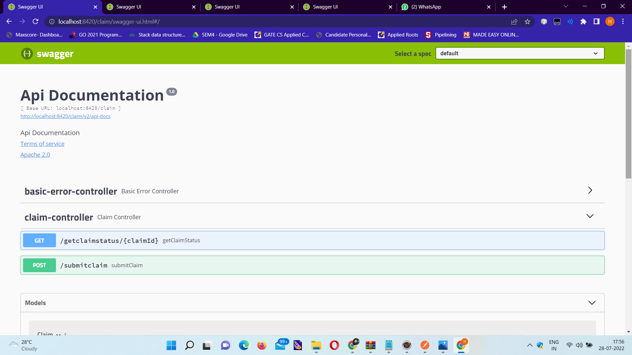
Claim Microservice EndPoints

Slide 14
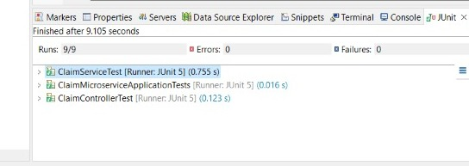
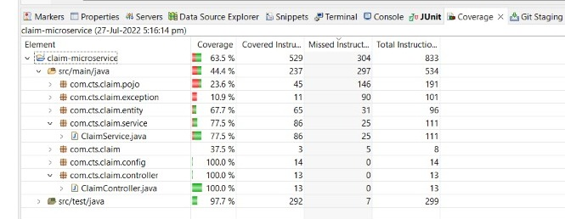
Claims Microservice Code Coverage

Slide 15
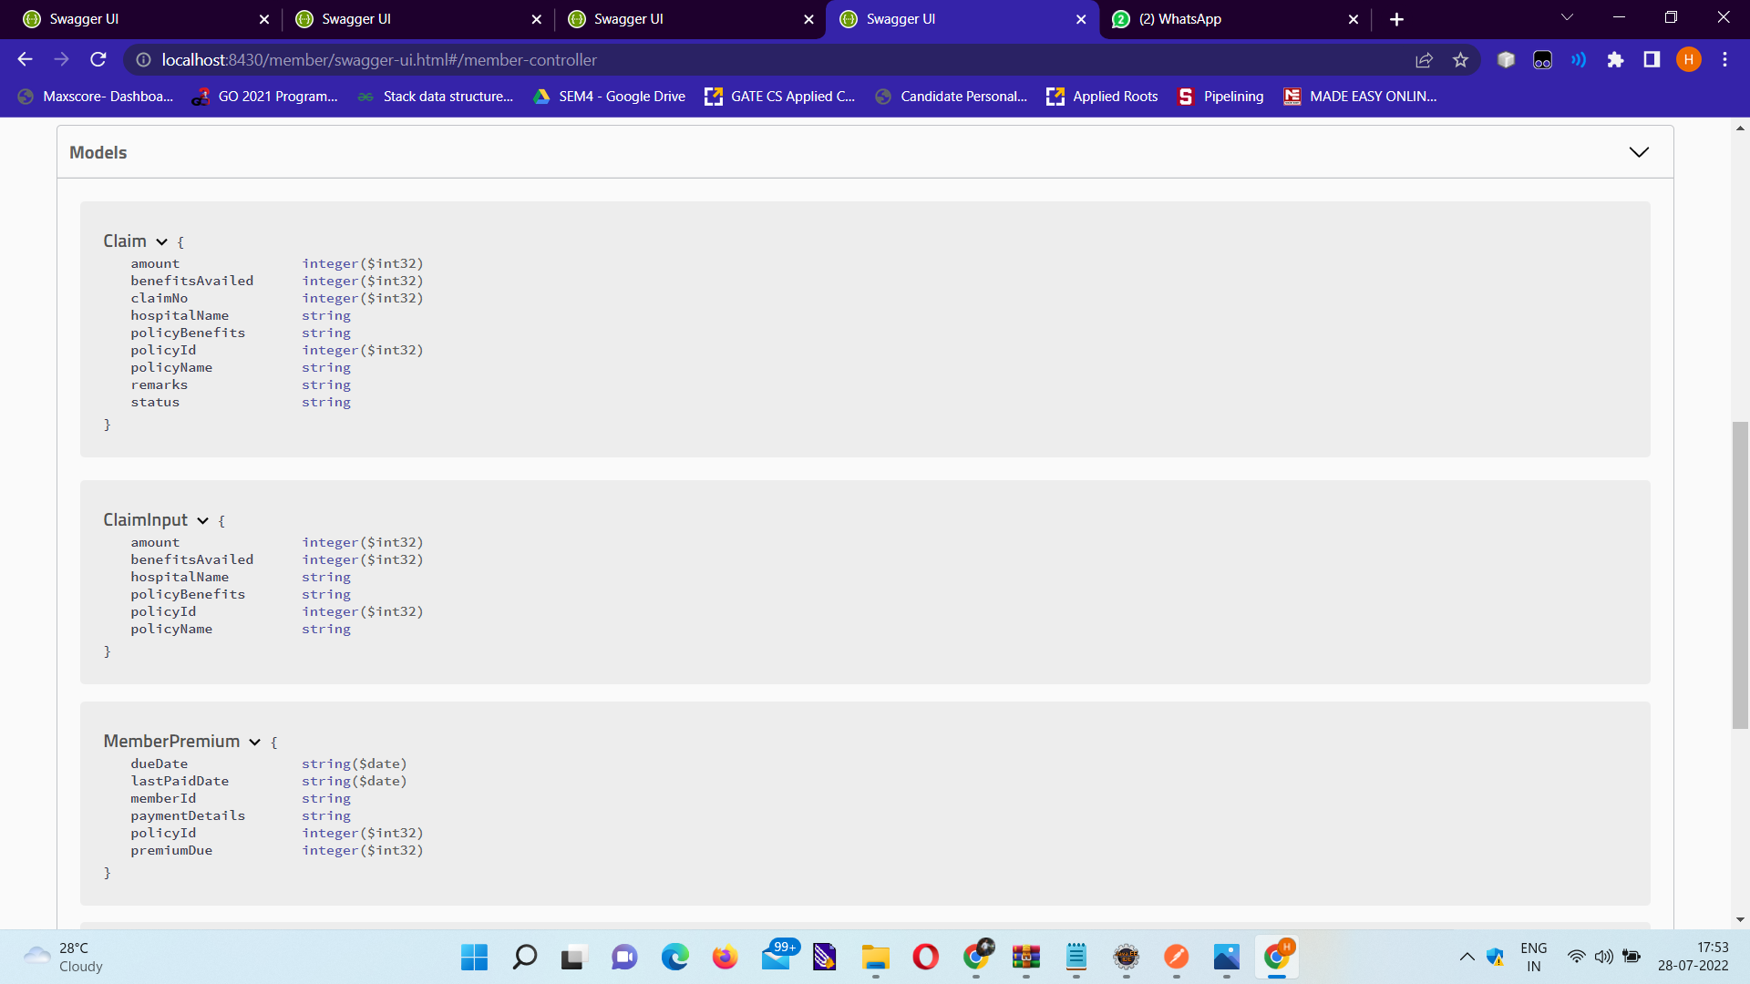
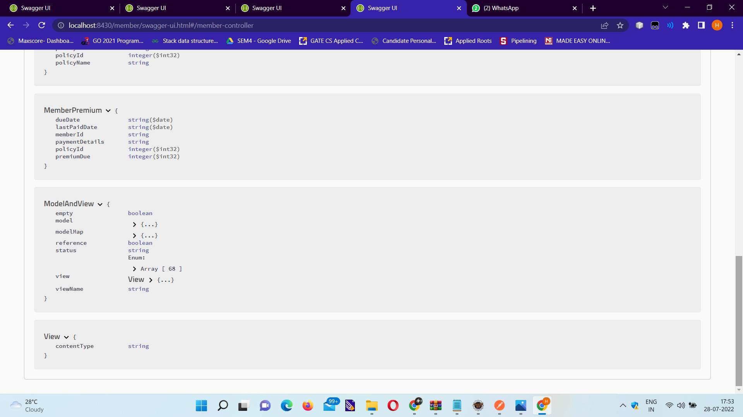
Member Microservice Model Classes

Slide 16
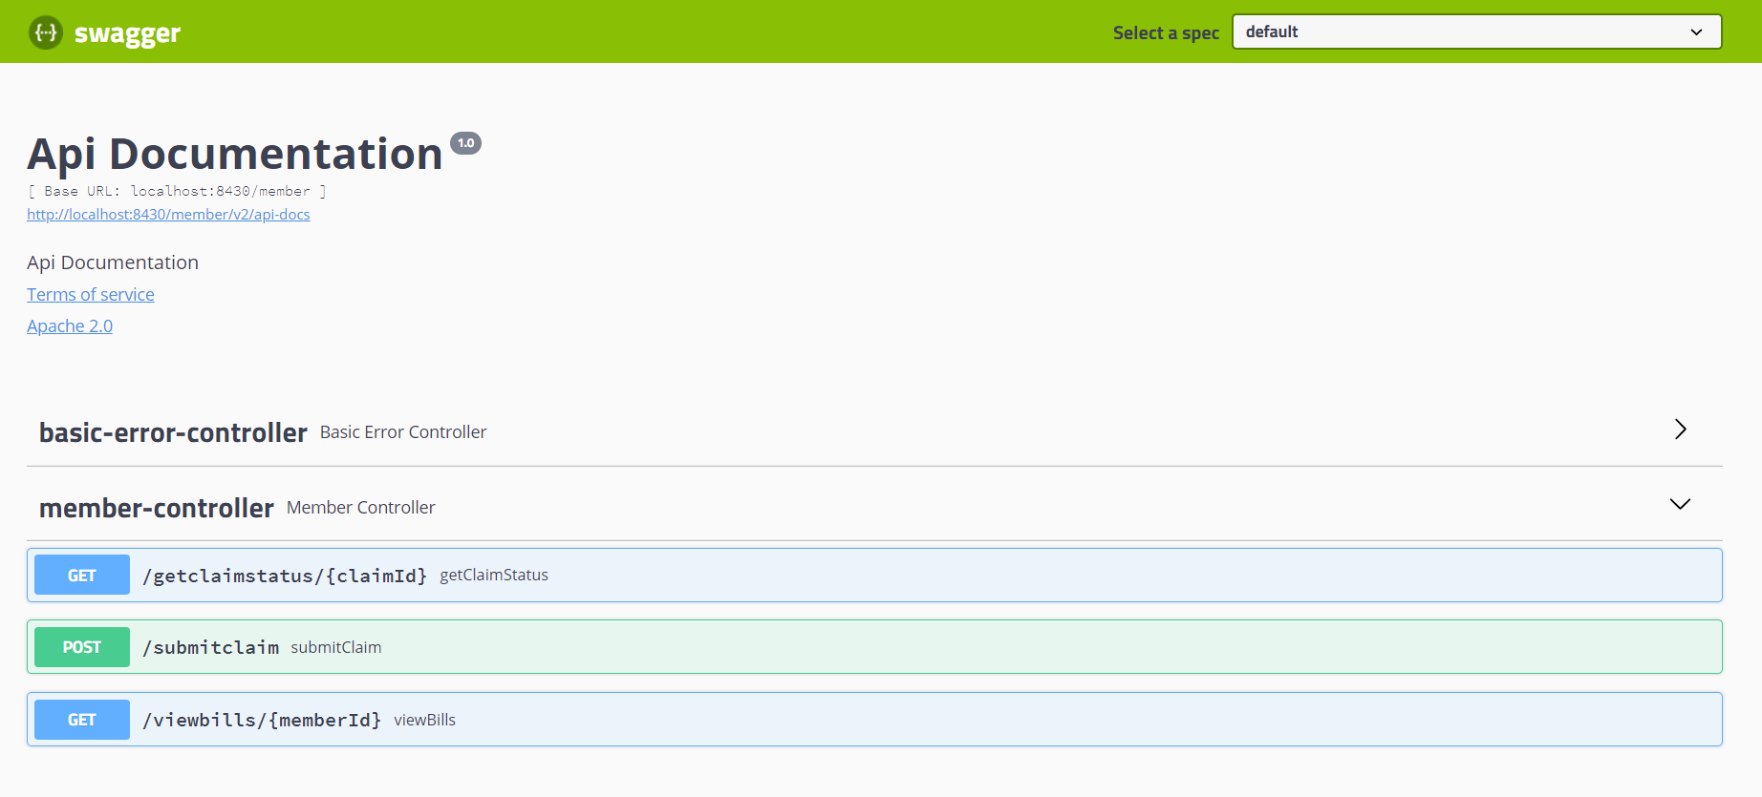
Member Microservice Endpoints

Slide 17
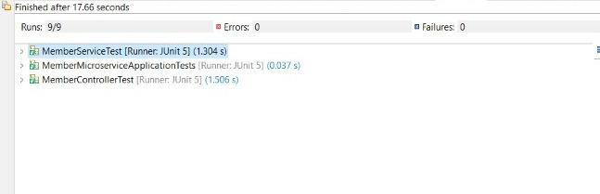
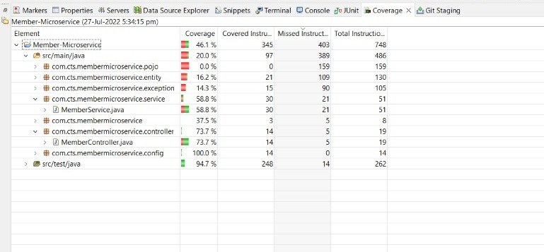
Member Microservice Code Coverage

Slide 18


WEB PORTAL ->

Slide 19
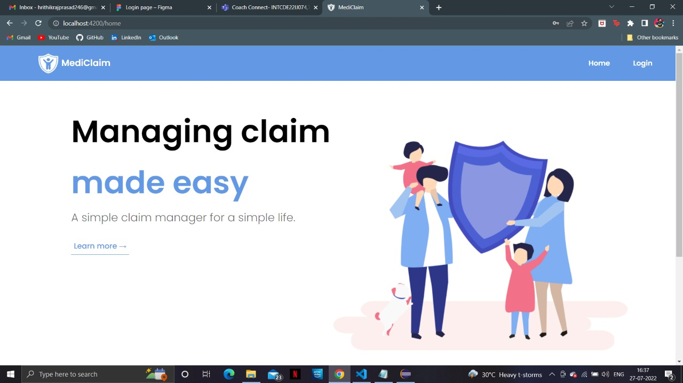
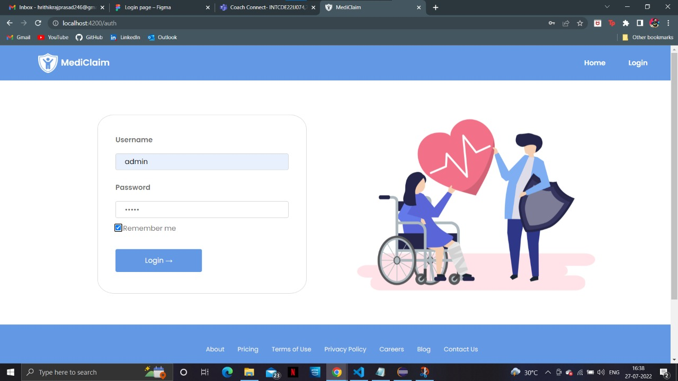
Home Page
Login Page

Slide 20
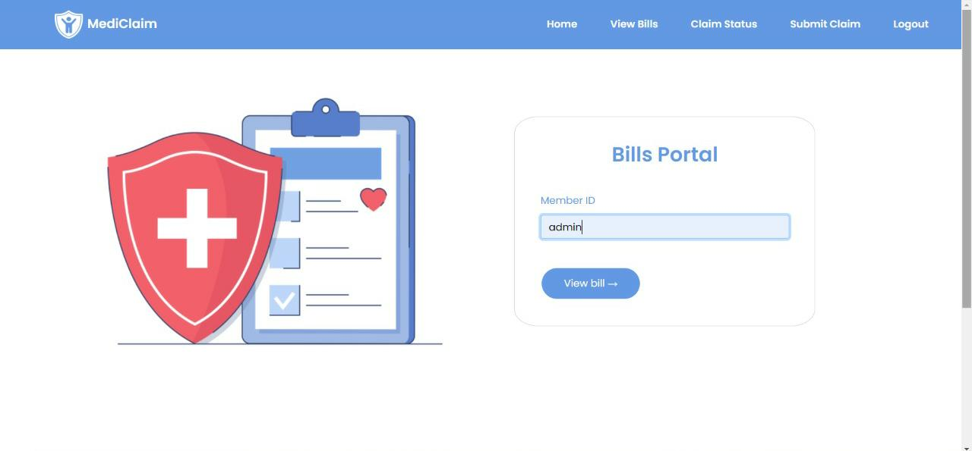
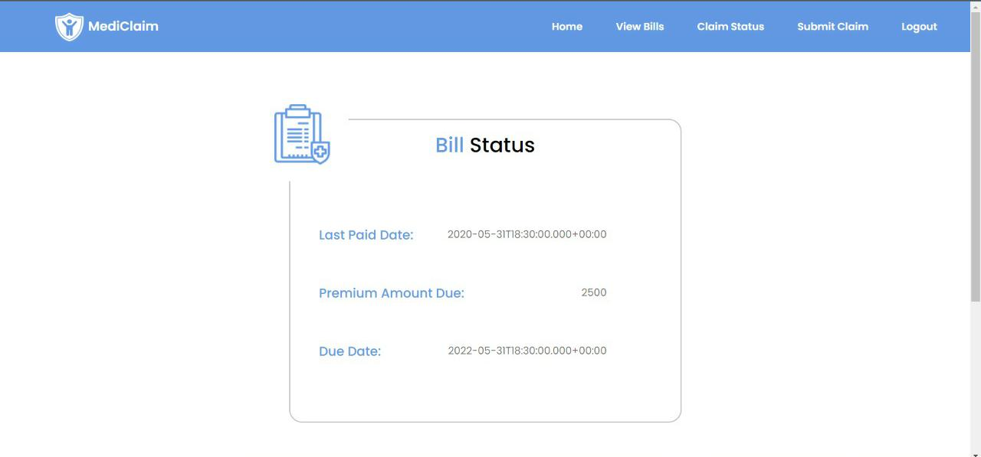
Bills Portal
Bill Status

Slide 21

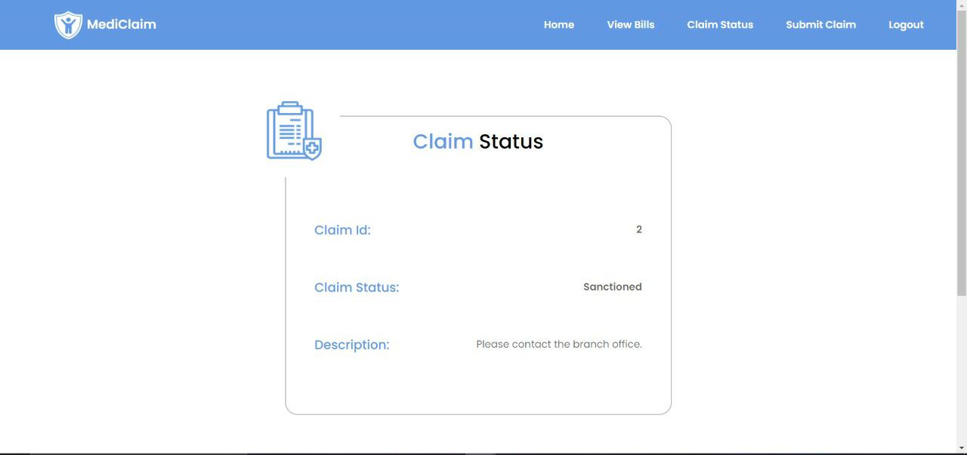
Claims Portal
Claims Status

Slide 22
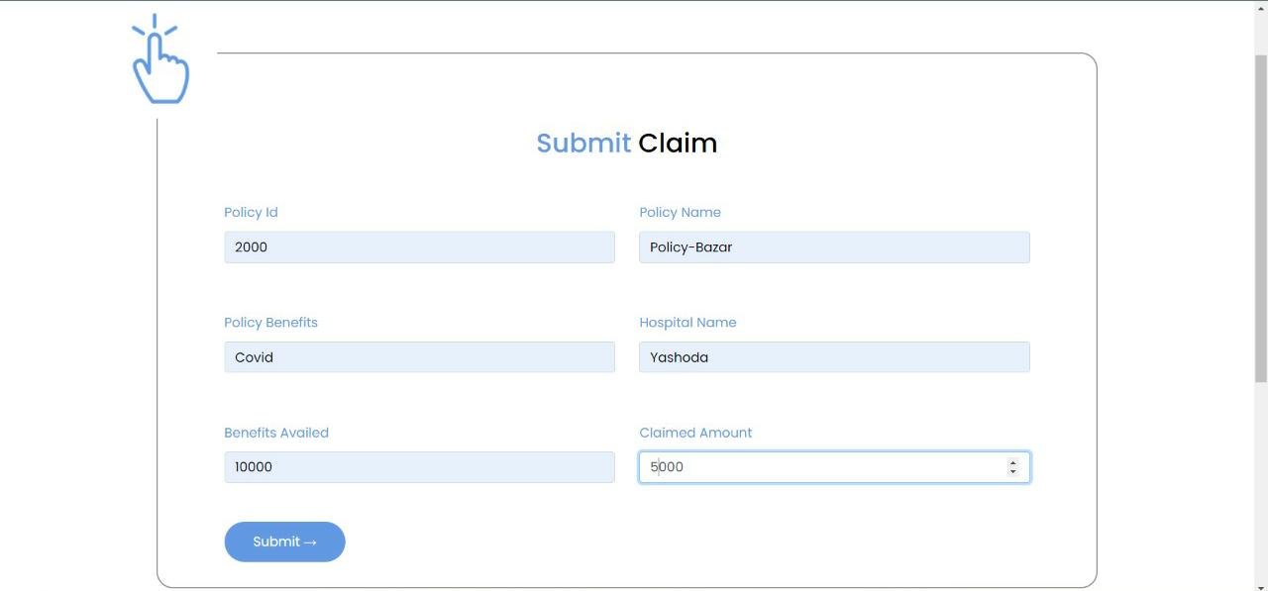
Submit Claim

Slide 23
H2 CONSOLE->

Slide 24
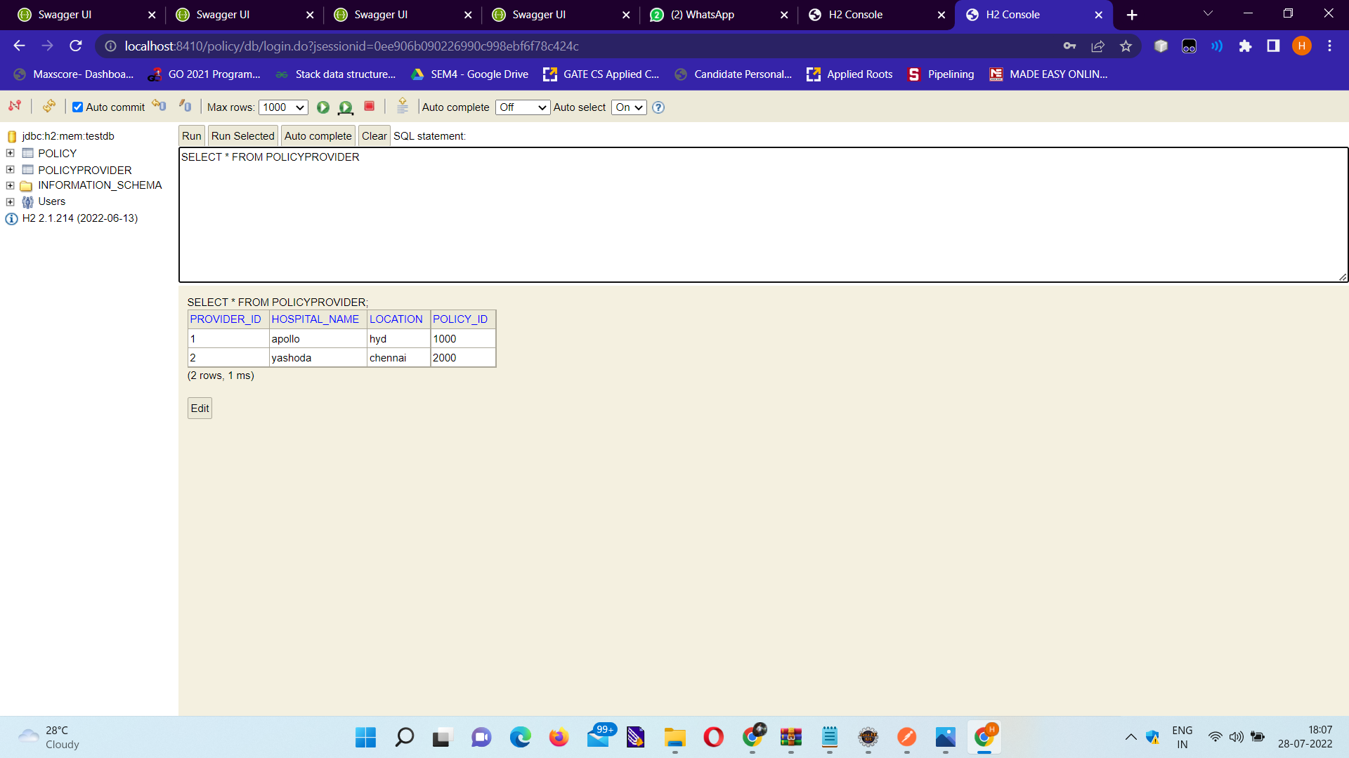
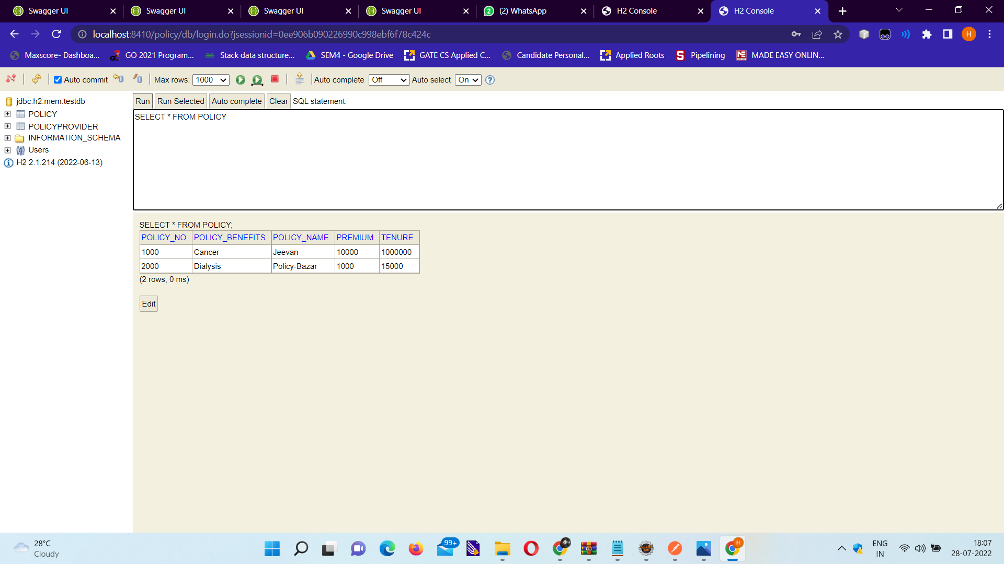
Policy

Slide 25
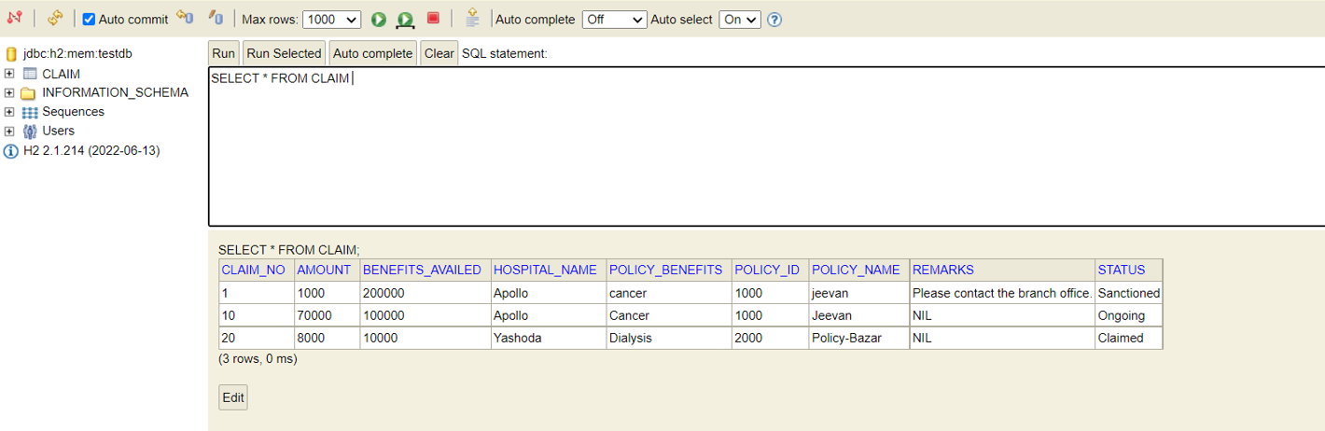
Claim

Slide 26
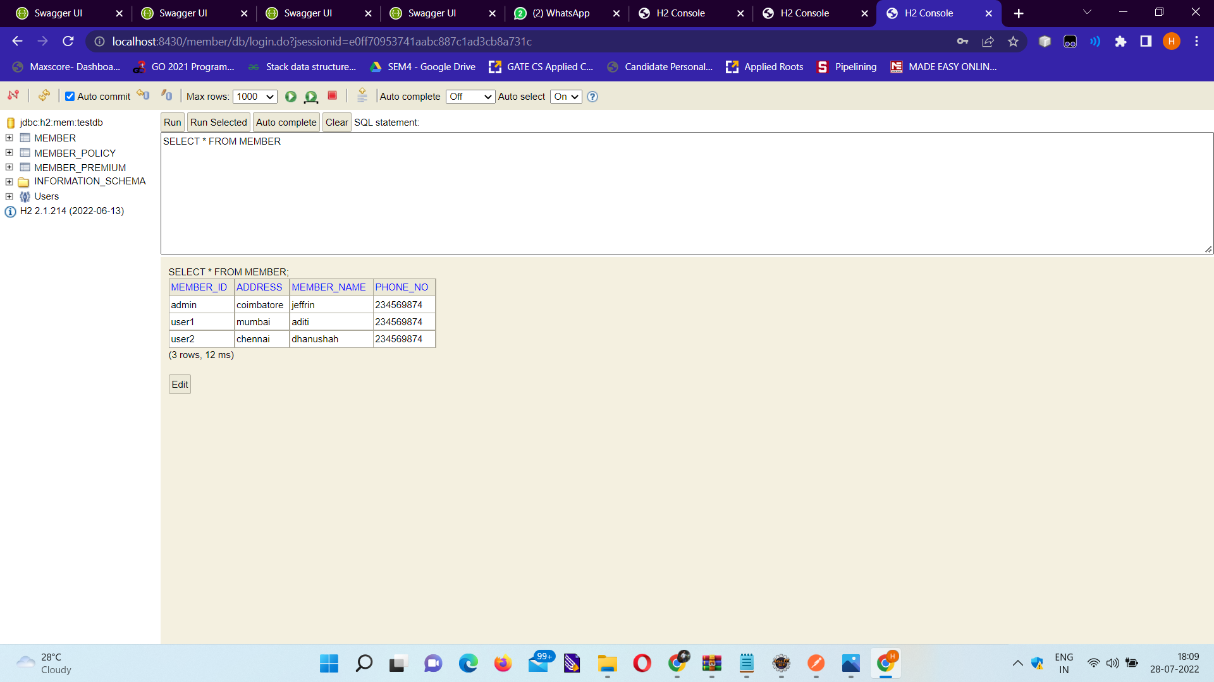
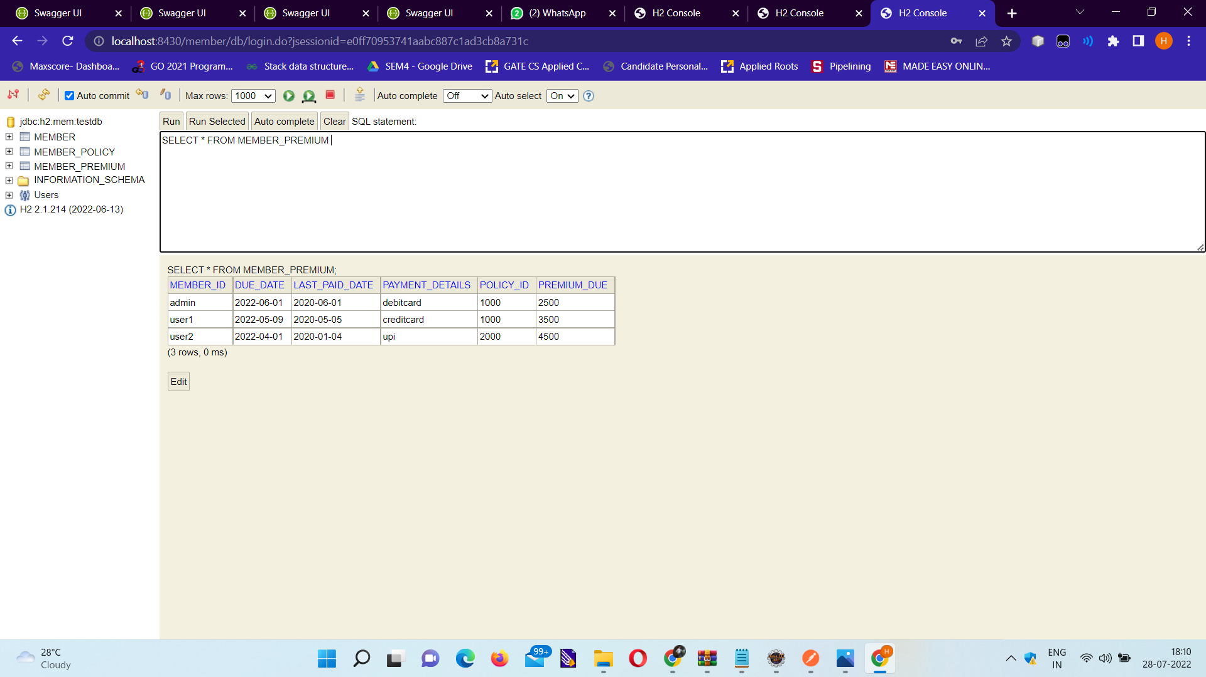
Member

Slide 27
Deployment in AWS->
(using Elastic Beanstalk)

Slide 28
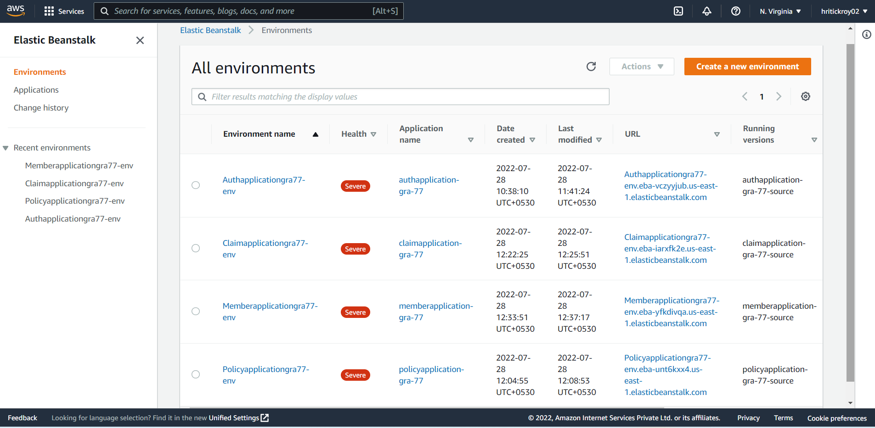
AWS Environment

Slide 29
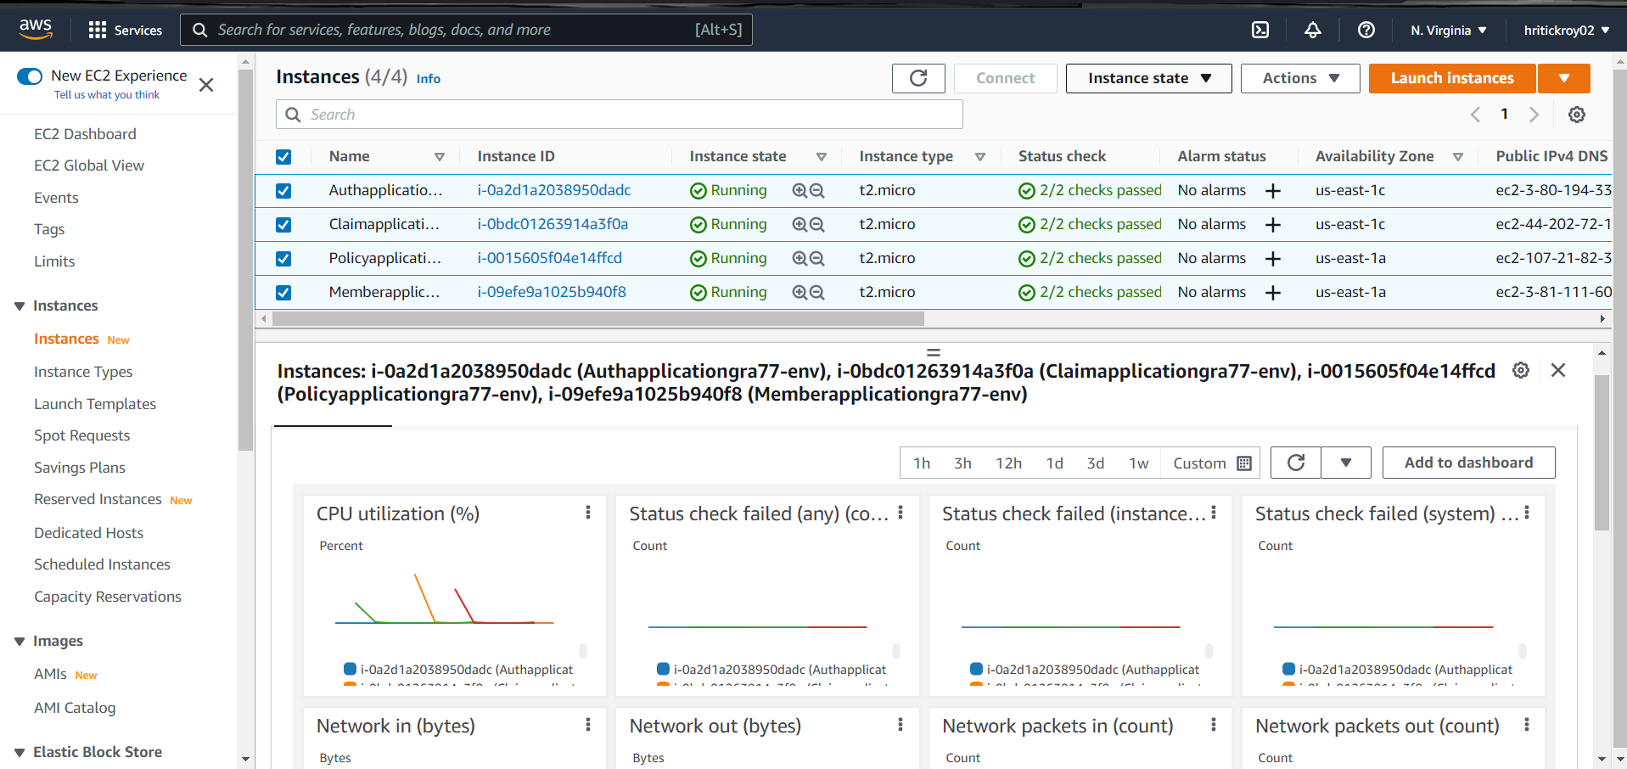
Instances

Slide 30
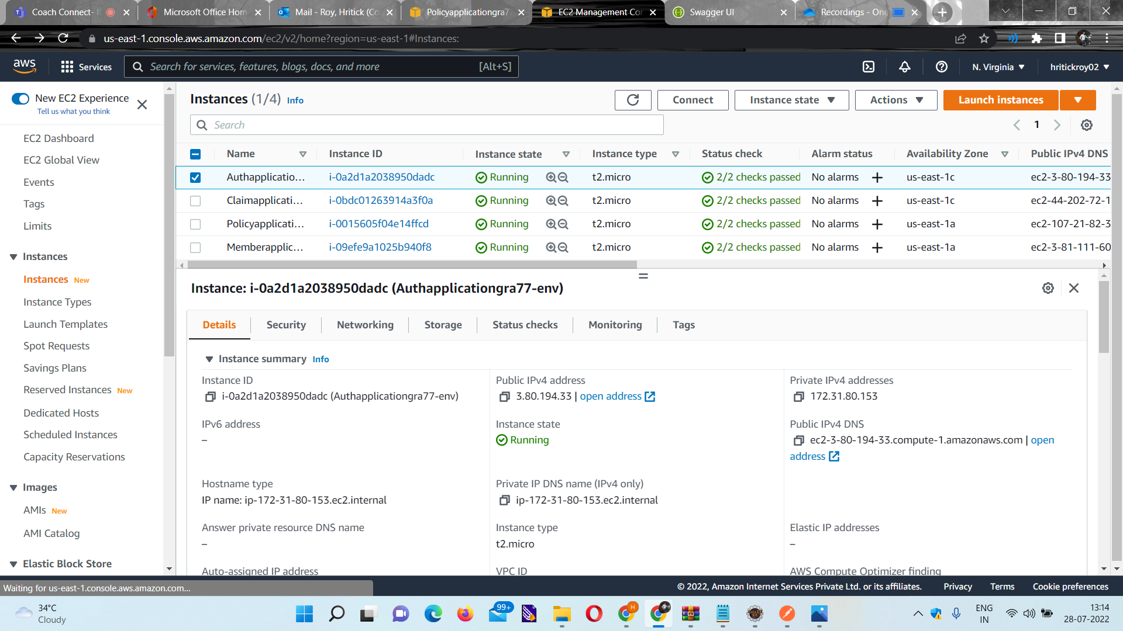
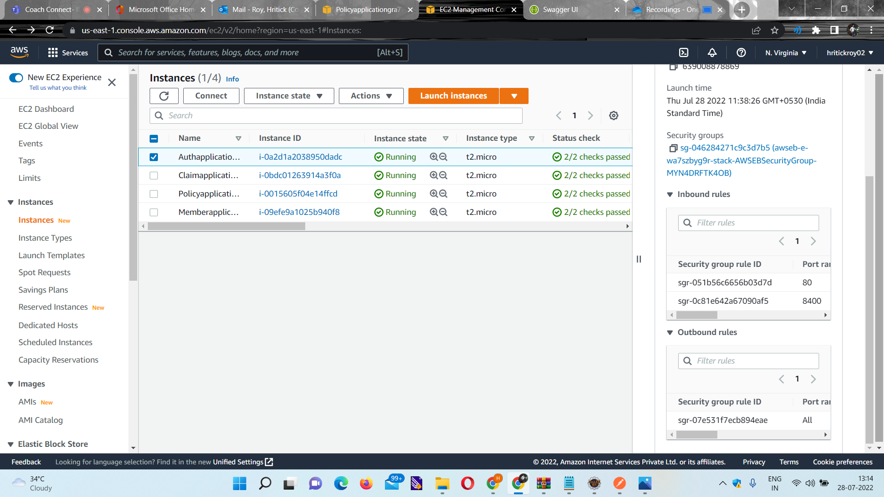
Authorization Microservice

Slide 31
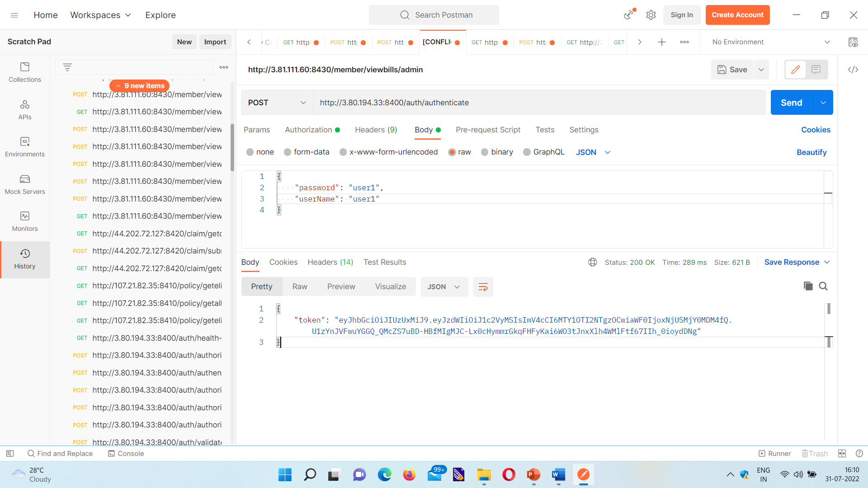
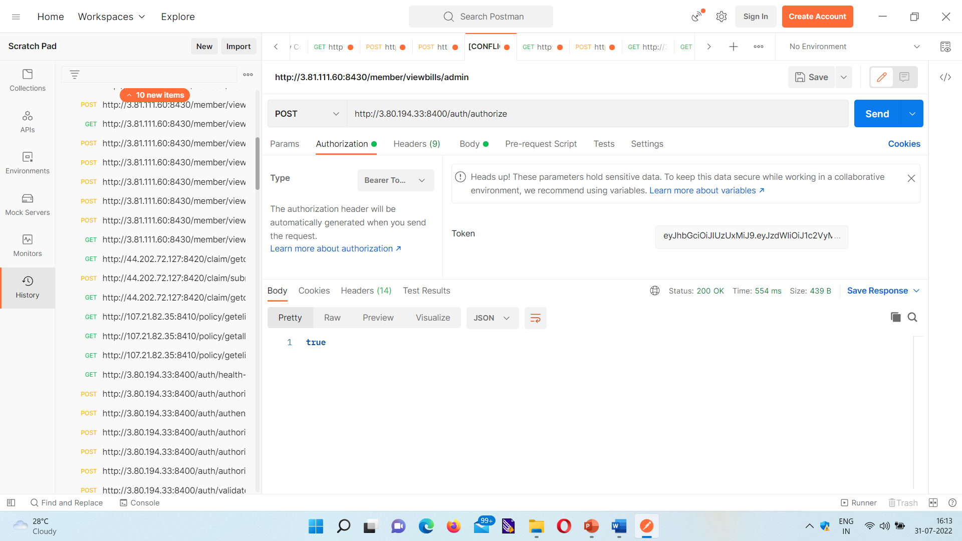
Authorization Microservice Endpoints

Slide 32
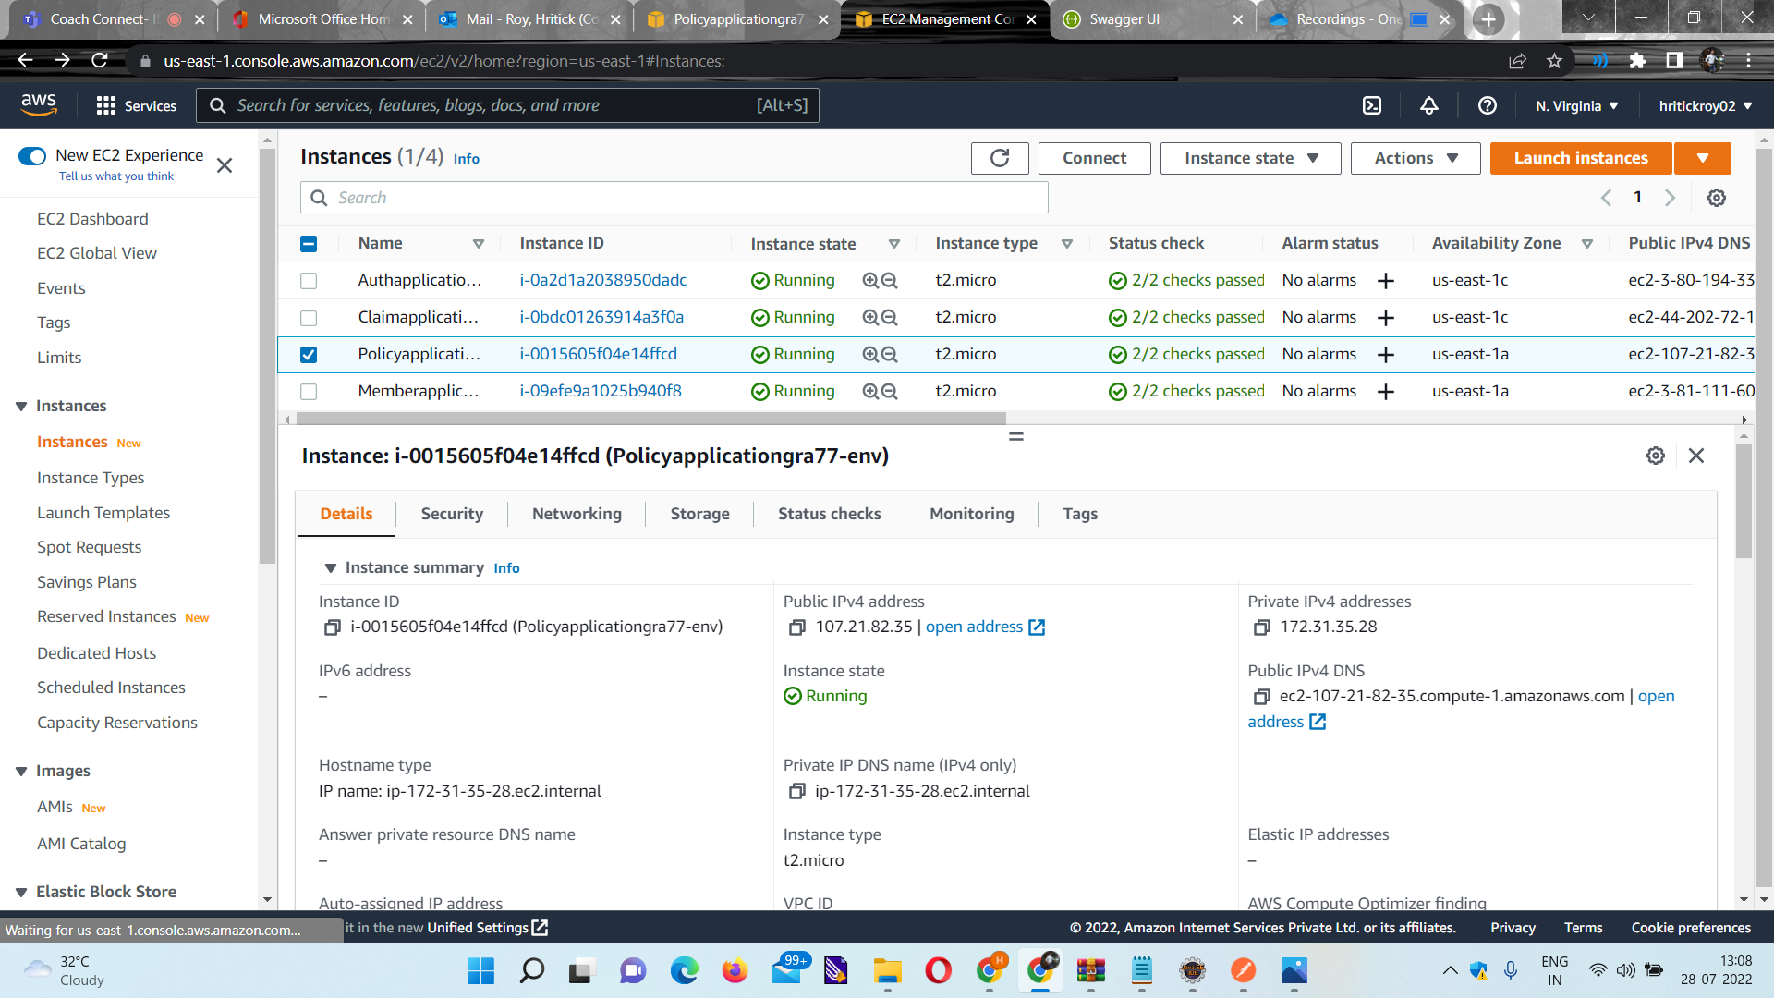
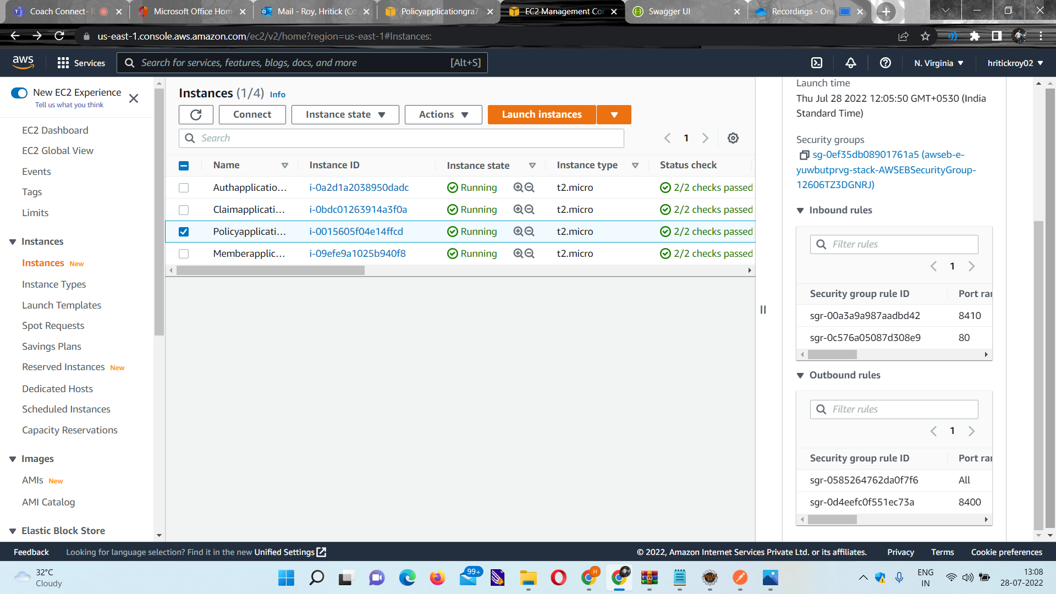
Policy Microservice

Slide 33
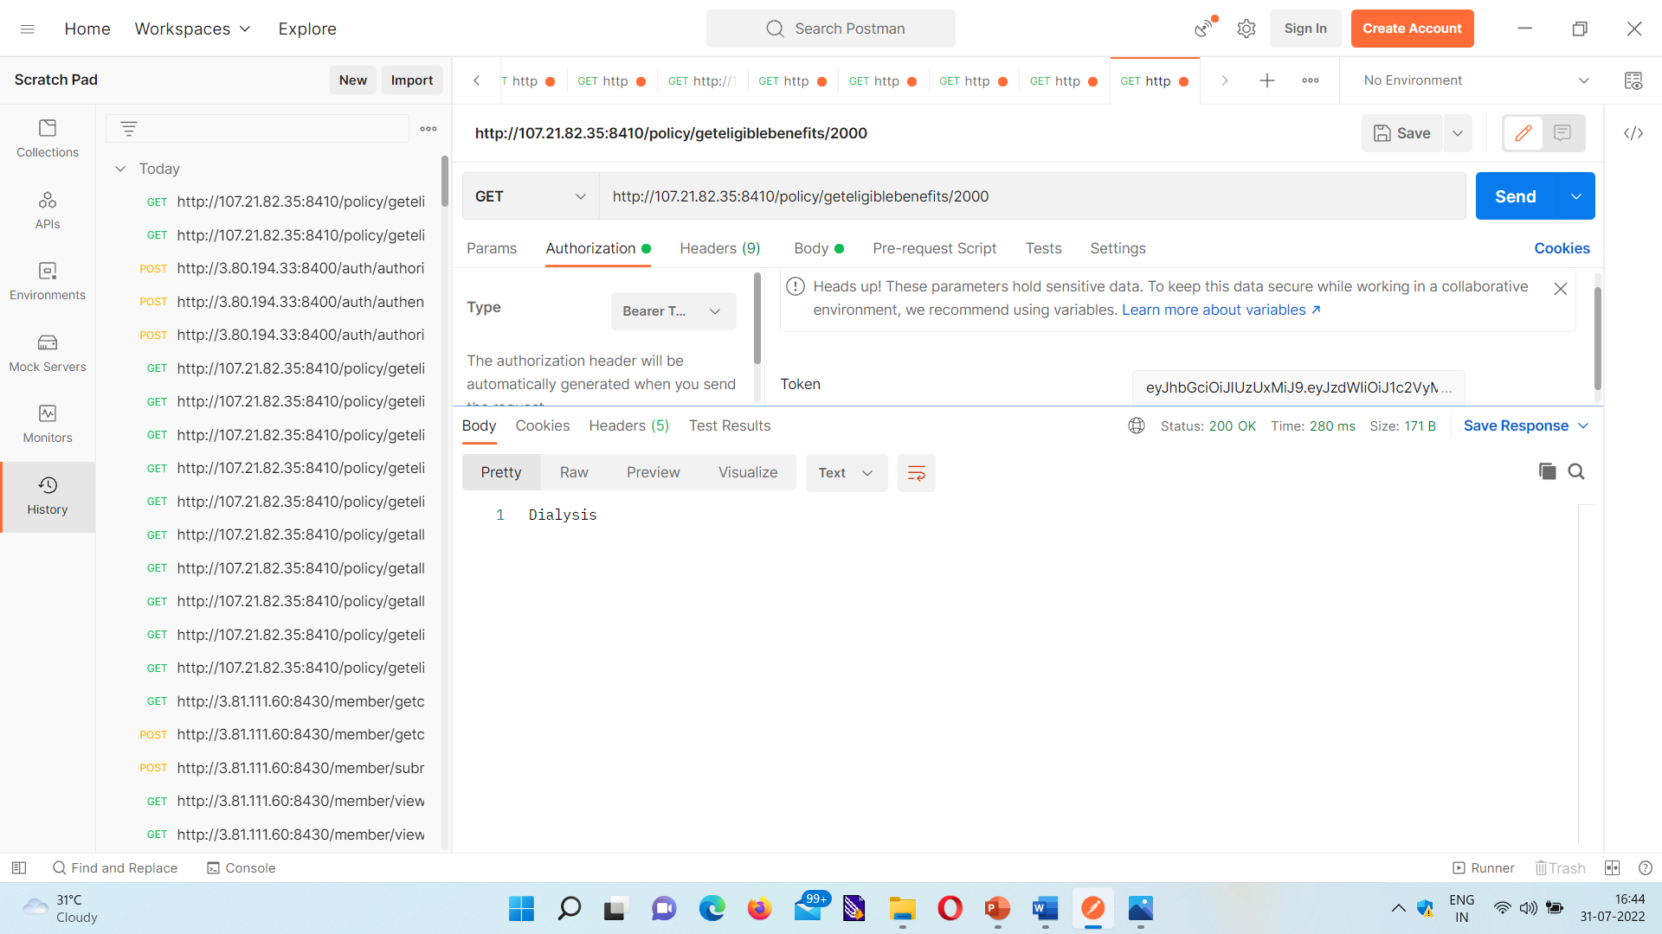
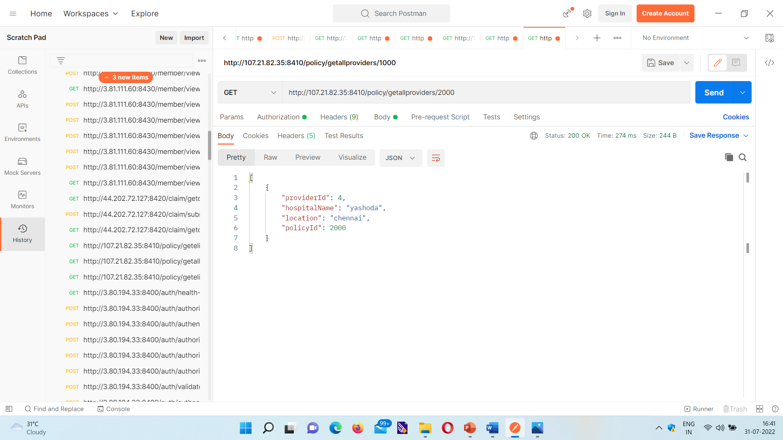
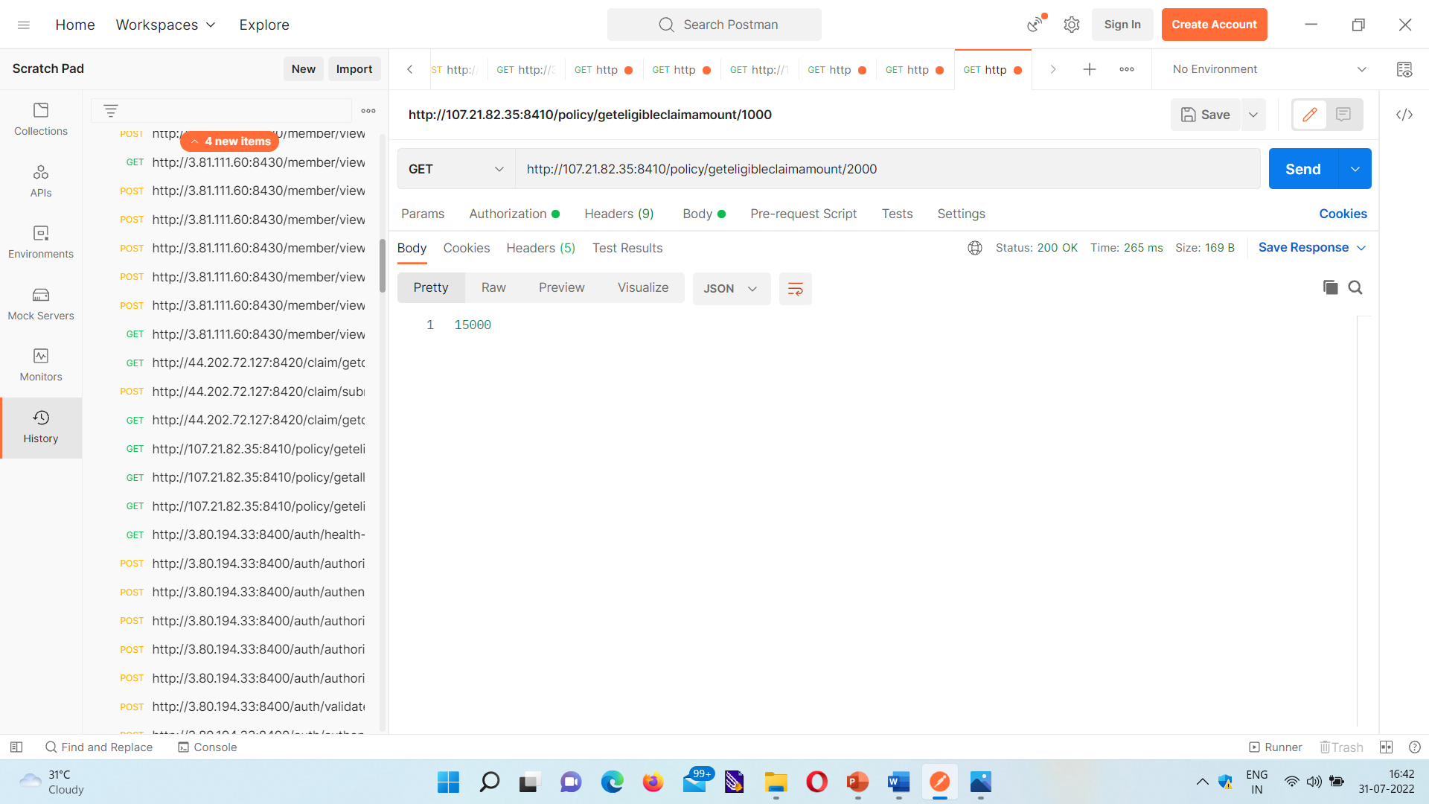
Policy Microservice Endpoints

Slide 34
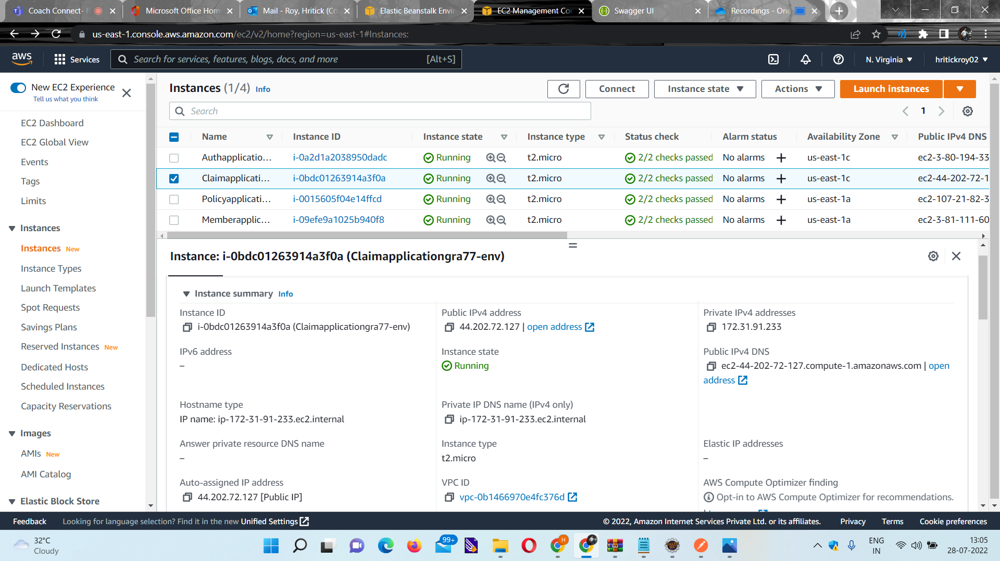
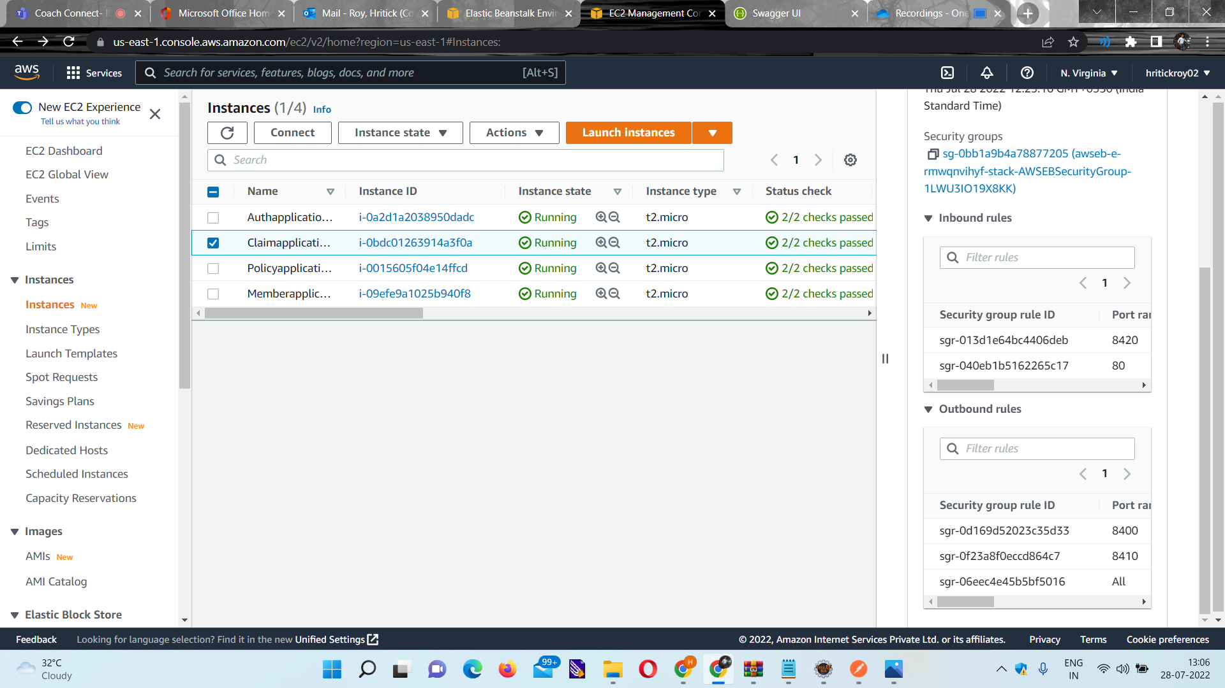
Claim Microservice

Slide 35
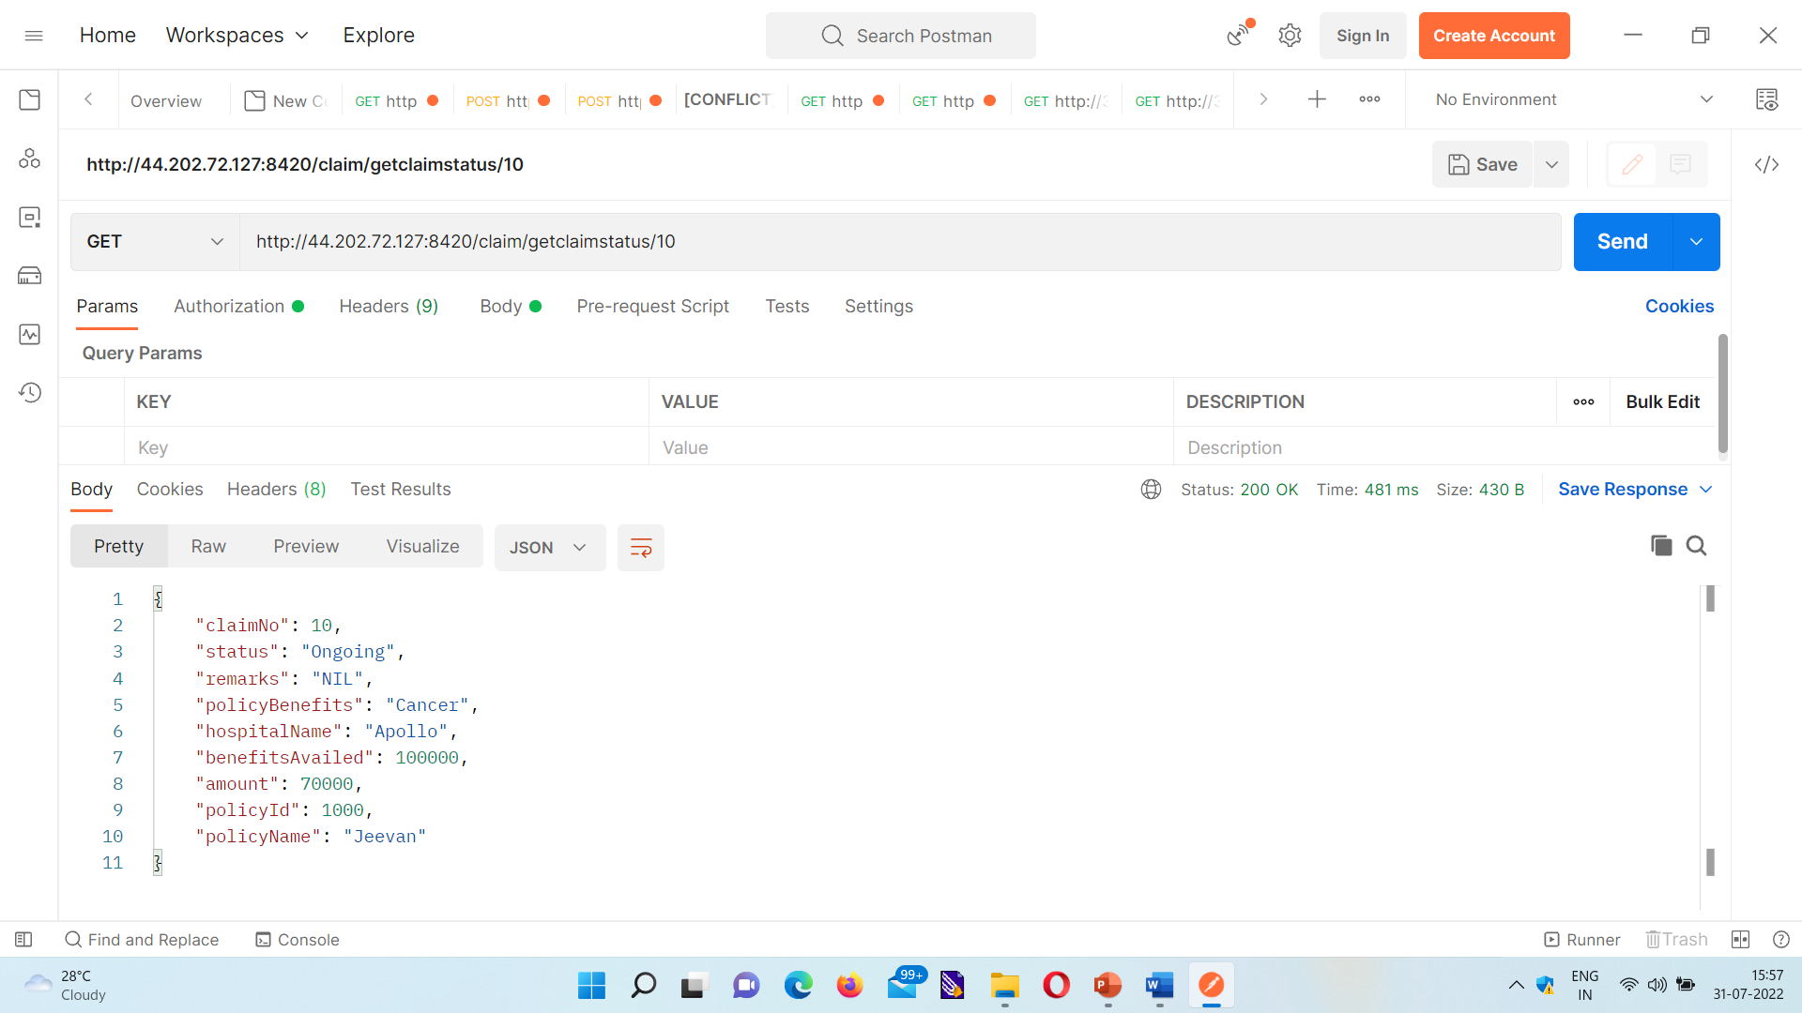
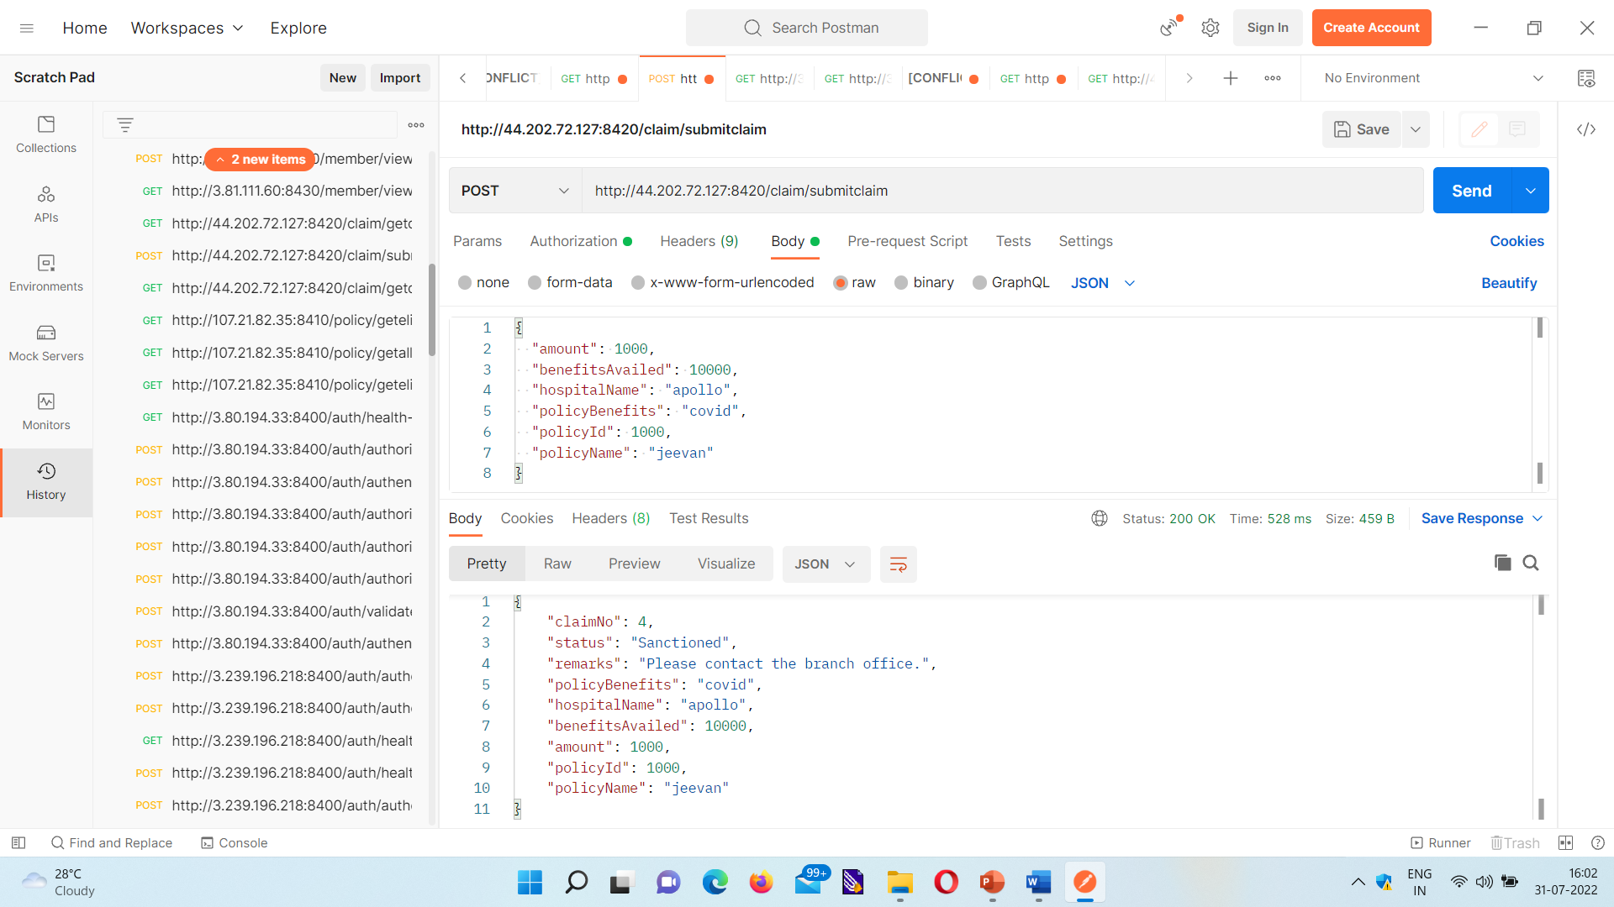
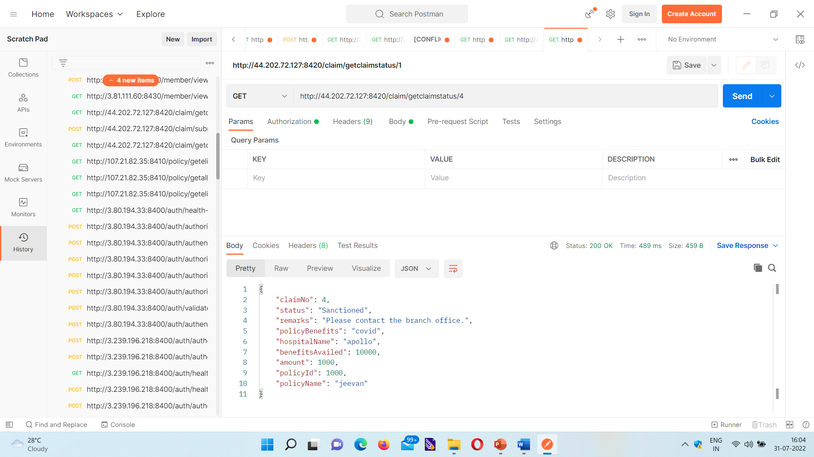
Claim Microservice Endpoints

Slide 36
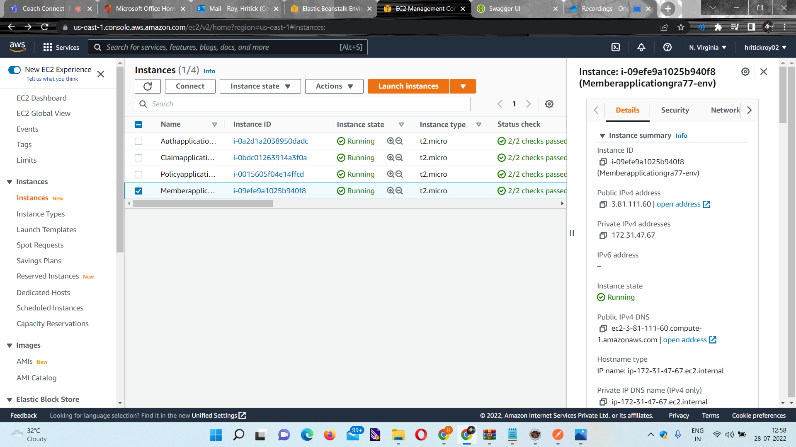
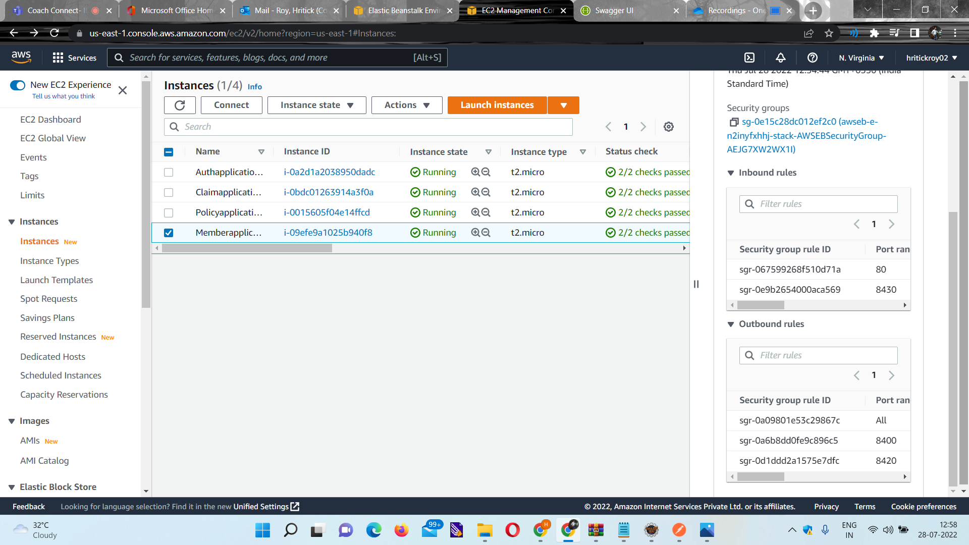
Member Microservice

Slide 37
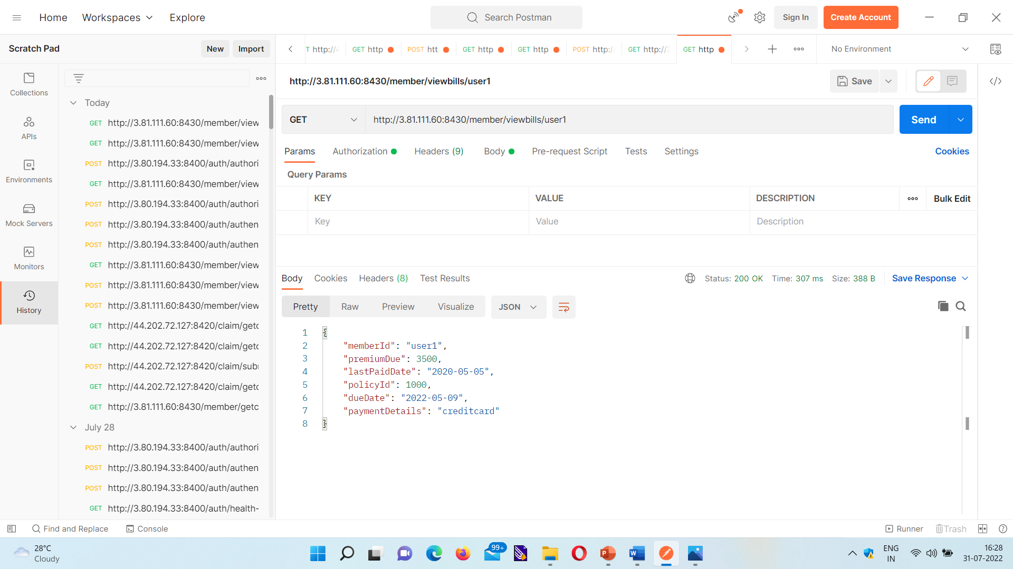
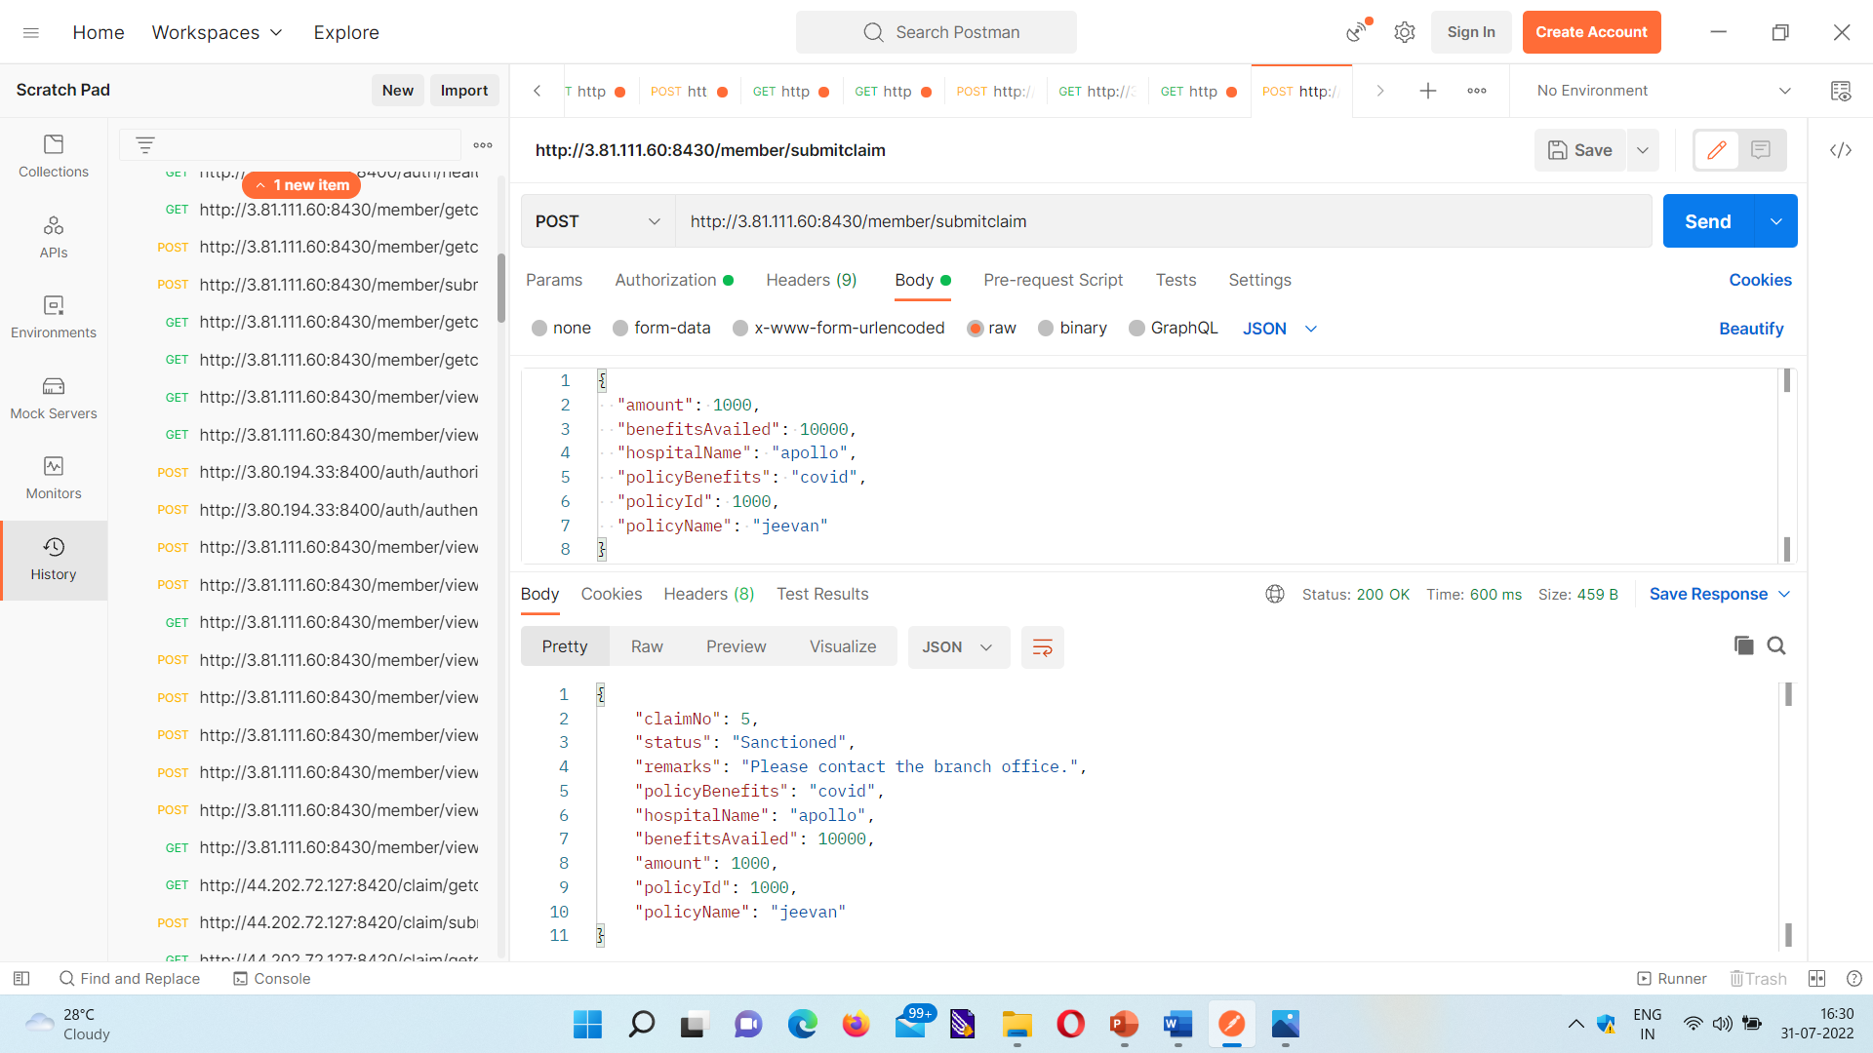
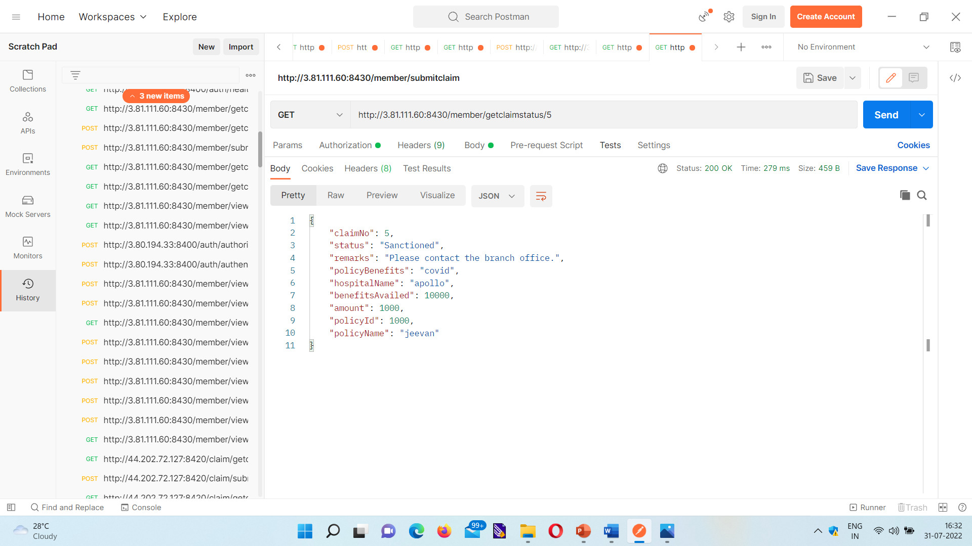
Member Microservice Endpoints

Slide 38
CONCLUSION
From this MFPE, we learnt how to work as a team.
We constantly shared the same code base among all the members simultaneously.
We used Spring Web MVC with Bootstrap Framework, Rest API, Spring Web Security.
Unit testing is done using Junit and Mockito.
The microservice communication is handled using feign client.
The web portal is built using Angular 8.
AWS Deployment is done using Elastic Beanstalk.

Slide 39
BIBLIOGRAPHY
stackoverflow.com
udemy.com
w3schools.com
docs.spring.io
getbootstrap.com

Slide 40
THANK YOU

